Slide 1
Windows Azure Service Bus
Kerry Jenkins
Application Architect
Data-Tronics Corp.

Slide 2







Arkansas Best Corporate Family
Arkansas Best Corporation
Data-Tronics Corp.
ABF Freight System, Inc.

Slide 3
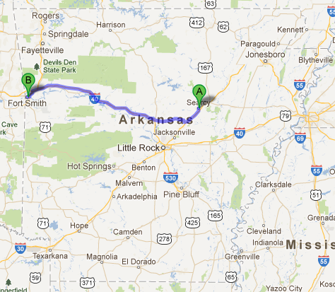
Fort Smith, Arkansas

Slide 4
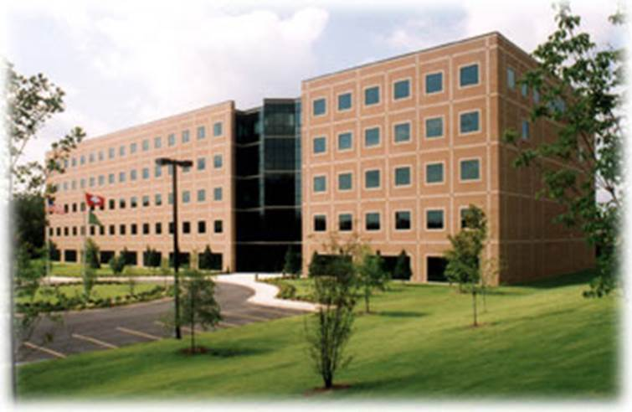

Slide 5
Harding graduates at DTC
Kerry Jenkins (1990)
Adrienne Wilson Kaminshine (2000)
Krista Anderson Dean (2001)
Suzanne Jenneman (2005)
Joe Morgan (2007)
Drew Spickes (2009)
Aaron Chism (2009)
Logan Mclain (2010)
Ben Pschierl (2011)

Slide 6
Windows Azure Service Bus
Kerry Jenkins
Application Architect
Data-Tronics Corp.

Slide 7
What is Windows Azure Service Bus?
Queues
Topics / Subscriptions
Relay
Notification Hubs

Slide 8

Special thanks to Clemens Vasters
Clemens Vasters (Technical Lead in Microsoft's PM team for the Windows Azure Service Bus) provided much of the graphics and content used in this presentation
http://channel9.msdn.com/Blogs/Subscribe
@clemensv

Slide 9
Programming Model Options
Apps
Windows
Whatever
.NET WCF Service Model
C/C++ (incl Embedded)
Apache Proton-C
Java/JMS
Apache Qpid JMS AMQP 1.0
Node.js client
.NET Service Bus Messaging API
Python client
PHP client
Any HTTP client
NetMessagingBinding
SB Messaging Protocol (net.tcp, proprietary)
AMQP 1.0
HTTP(S)
Service Bus

Slide 10
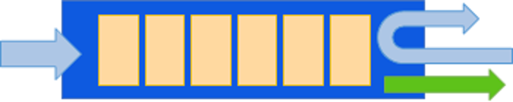
Queues

Slide 11
Brokered Message
Sys Properties
Key
Value
Key
Value
Key
Value
Custom Properties
64KB max
256 KB max
Key
Value
Key
Value
Key
Value
Key
Value
Body
Body (Bag of Bytes)

Slide 12
Message Protocol Mapping: SOAP
SOAP Message
Brokered Message
Headers
Properties
explicit promotion
Hdr
Value
Key
Value
Hdr
Value
Key
Value
Hdr
Value
Key
Value
Hdr
Value
Key
Value
Entity Body
Body
Entity
Body

Slide 13
Message Protocol Mapping: HTTP
HTTP Message
Brokered Message
BrokerProperties
Sys Properties
Headers
Key
Value
BrokerProperties
{ json }
Key
Value
Hdr
Value
Key
Value
Custom Properties
Hdr
Value
Key
Value
Hdr
Value
Key
Value
Hdr
Value
Key
Value
Key
Value
Entity Body
Body
Entity
Body (Bag of Bytes)

Slide 14
Receive from Queue Options
R
Receive and Delete

Slide 15
Receive from Queue Options
R
1. Peek/Lock
2. Delete/Unlock

Slide 16
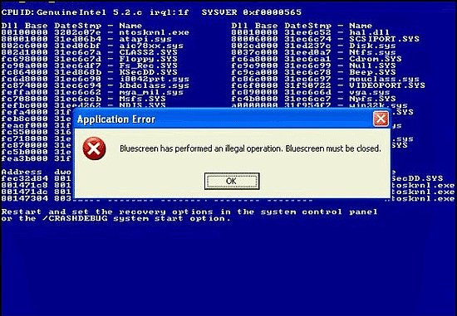
Demo – Queues

Slide 17
Why use a Queue?
Load Leveling

Slide 18
Why use a Queue?
Load Leveling
R
S
R
Queue
R

Slide 19
Why use a Queue?
Offline / Batch
S
R
Queue

Slide 20
Why use a Queue?
Decouples Sender from Receiver
?
S
R
Queue

Slide 21
Questions on Queues?

Slide 22
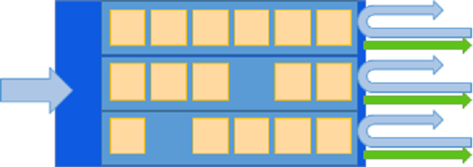
Topics / Subscriptions

Slide 23
Topics / Subscriptions
R
S
Sub
R
Topic
Sub
Sub
R

Slide 24
Topic / Subscription - Filtering
R
S
Sub
R
Topic
Sub
Sub
R
Name LIKE 'V%'

Slide 25
Topic / Subscription - Partitioning
PartId > 0 AND PartId <= 272
R
S
PartId > 272 AND PartId <= 567
Sub
R
Topic
Sub
Sub
PartId > 567 AND PartId <= 791
R

Slide 26

Demo - Topics / Subscriptions

Slide 27
Questions on Topics / Subscriptions?

Slide 28
Special Features of Queues / Topics

Slide 29
Time To Live
S
Broker Message
R
Properties
Queue/Topic
TTL
5 min
…
…
Body
var message = new BrokeredMessage(msgBody)
{
MessageId = msgId,
TimeToLive = TimeSpan.FromMinutes(1)
};

Slide 30
Scheduling
S
Broker Message
R
Properties
Queue/Topic
At
15:00:00
…
…
Body
var message = new BrokeredMessage(msgBody)
{
MessageId = msgId,
ScheduledEnqueueTimeUtc = DateTime.UtcNow.AddHours(2)
};

Slide 31
Dead-Lettering
receivedMessage.DeadLetter( "UnableToProcess", "Unrecoverable exception while processing");
QueueClient deadLetterClient = messagingFactory.CreateQueueClient( QueueClient.FormatDeadLetterPath(queueClient.Path), ReceiveMode.ReceiveAndDelete);

Slide 32
Duplicate Detection
namespaceManager.CreateQueue( new QueueDescription(queueName) { RequiresDuplicateDetection = true, DuplicateDetectionHistoryTimeWindow = TimeSpan.FromHours(1) });
var message = new BrokeredMessage(msgBody)
{
MessageId = msgId
};

Slide 33
Service Pricing* Queues and Topics/Subscriptions
USD $0.01 per 10,000 message transactions
Sending a message of up to 64KByte size = 1 tx
Each further 64KB segment = 1tx
Receive a message of up to 64KByte in size = 1tx
Each long-polling operation (60s timeout) even if yielding no message = 1tx
Outbound Windows Azure traffic surcharges (ext. receivers)
Only affects outbound traffic, does not affect intra-datacenter traffic
Zone 1: $0.05-$0.12 per GByte, Zone 2 (Asia DCs): $0.12-$0.19 per GByte
*February 2013

Slide 34
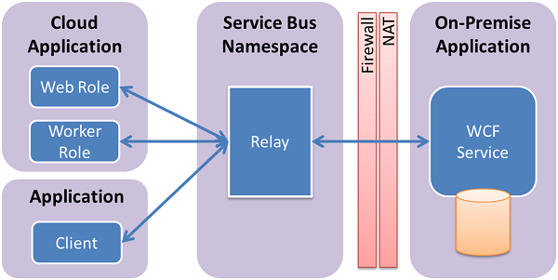
Relay
http://www.windowsazure.com/en-us/develop/net/how-to-guides/service-bus-relay/

Slide 35
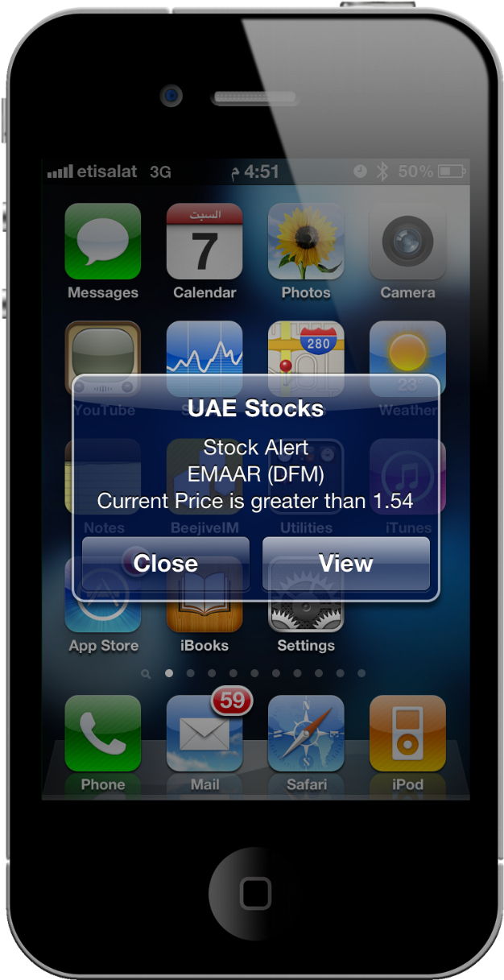
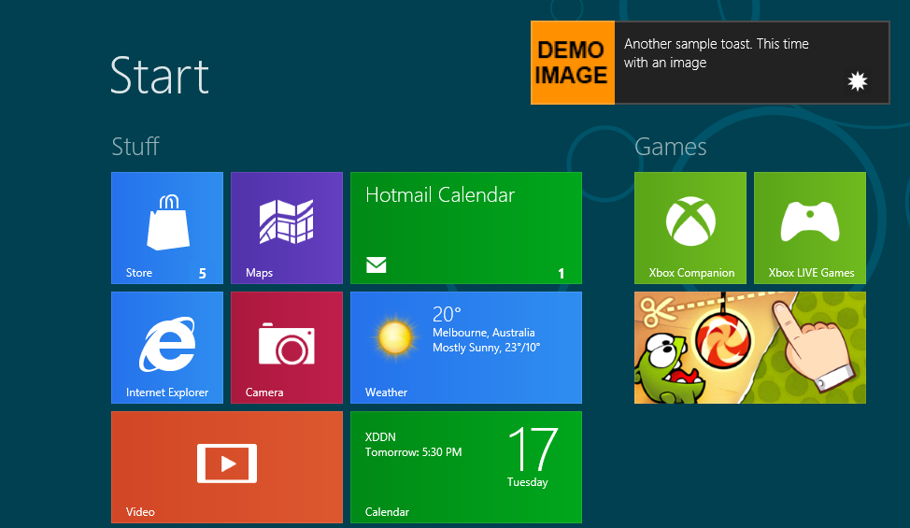
Notification Hubs

Slide 36
Final thoughts…

Slide 37
Questions? Please interview with Data-Tronics in the fall! Code and links: https://github.com/KerryJenkins/Harding

Slide 38
Thank You For Listening!
© 2012 Microsoft Corporation. All rights reserved. Microsoft, Windows, Windows Vista and other product names are or may be registered trademarks and/or trademarks in the U.S. and/or other countries.
The information herein is for informational purposes only and represents the current view of Microsoft Corporation as of the date of this presentation. Because Microsoft must respond to changing market conditions, it should not be interpreted to be a commitment on the part of Microsoft, and Microsoft cannot guarantee the accuracy of any information provided after the date of this presentation. MICROSOFT MAKES NO WARRANTIES, EXPRESS, IMPLIED OR STATUTORY, AS TO THE INFORMATION IN THIS PRESENTATION.

